Slide 1

Developing OpenResty Framework
Using Decoupled Libraries
by Aapo Talvensaari @ OpenResty Con 2015

Slide 2
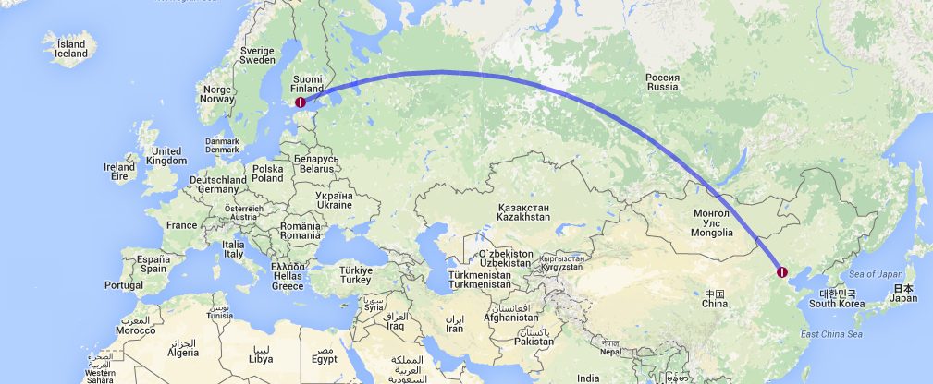
Where Did I Get Here?
About 6.500 Kilometers – Almost Nothing Compared to The Length of The Great Wall of China

Slide 3

Who Am I? professionally
WEB PROGRAMMER SINCE 90’S
ColdFusion ➠ ASP ➠ PHP ➠ Java ➠ ASP.NET ➠ OpenResty
SYSTEM ADMINISTRATOR
Linux and Windows Platforms, and Cloud
JOB
IT Manager at Aalto Capital Oy
Founder of Talvensaari Solutions Oy
Notes:
Basically I’m a Web Programmer. I started with ColdFusion and Microsoft’s original ASP in 90’s. Then it was mostly PHP from version 3 to 4.

Slide 4
What to Expect?
Short History
Basis for Building Web Applications
Routing
Templating
Validation and Filtering
Sessions
Style Sheets
Libraries
Kronometrix Analytics
In addition to English with Finnish accent, I will show you some of my libraries and how they work together.
Checkout also Leaf Corcoran’s Excellent Lapis Framework:
http://leafo.net/lapis/

Slide 5
Why OpenResty?
I wanted to expand skills, and learn something new
I wanted to get a rid of gateway interfaces – less moving parts
A real web server with scripting language support (Basically a new Apache + mod_php with a modern twist, e.g. Web Sockets support)
I was already using Nginx
Alternatives that I looked (All the alternatives actually looked really nice, but I felt more comfortable with OpenResty)
Node.js (I didn’t enjoy JavaScript, and it wasn't using a real web server)
Python / Ruby (too object oriented, usually behind a gateway interface)
Go (not a scripting language, no particular web development focus)
Simplicity, both in development and deployment, and performance

Slide 6



OpenResty Stack
Nginx
OpenResty
Lua
by Igor Sysoev et al.
Web Server
by Yichun Zhang et al.
Web Application Server
by Roberto Ierusalimschy et al.
Programming Language

Slide 7
Routing lua-resty-route
local r = require "resty.route"
local route = r.new()
-- Use a Middleware
-- (not needed in this example)
route:use "reqargs" {}
-- Add HTTP GET Route
route:get("/hello", function()
ngx.print "世界你好"
end)
-- Dispatch the Request
route:dispatch()
Nginx already does routing! Why oh why?
Makes web development enjoyable! Works as a glue.
Nginx configuration can be fairly static
Nice DSL for Specifying Route Handlers
Middleware
Before and After Filters
Web Sockets Routing
Pluggable Matchers
Simple – ngx.re.match + pre-defined :string and :number matchers
Regex – ngx.re.match
Match – string.match
Equals – plain ==, no pattern or string matching

Slide 8
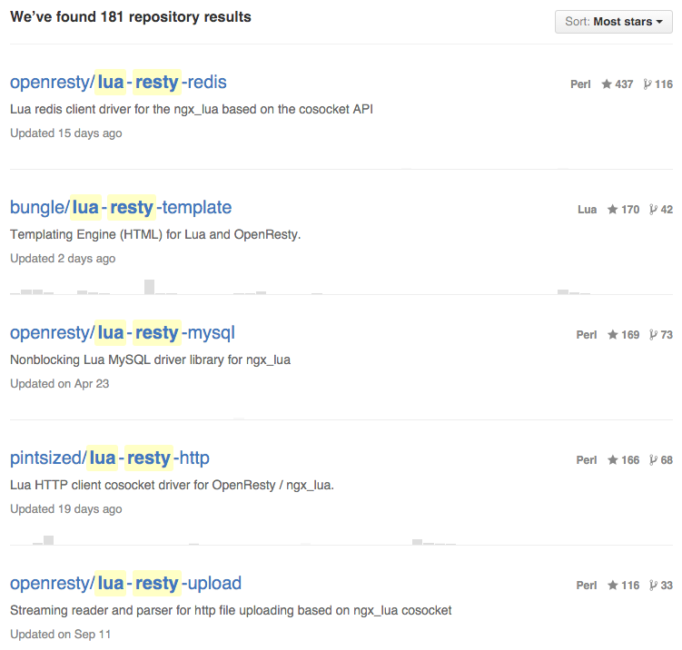
Templating lua-resty-template
One of the Top OpenResty Libraries in GitHub
It's a Compiling Templating Engine
Just Another Way to Write Lua
Almost all you can do in Lua, you can do in Template
Basically it is just plain string concatenation after all (white space and line-feed handling is fine tuned)
Supports Lua / LuaJIT / OpenResty
Handwritten Parser Using string.find
Features
Layouts
Blocks
Include
Comments
Verbatim / Raw Blocks
Automatic Escaping
Precompilation
Caching
Preloading (WIP)

Slide 9
<!DOCTYPE html>
<html lang="{{lang}}">
<head>
<meta charset="{{charset}}">
<title>{{title}}</title>
{*blocks.styles*}
{#
Commented out, because it causes a problems (see issue #35):
<script src="js/analytics.js"></script>
#}
{-head_scripts-}
<script src="js/app.js"></script>
{-head_scripts-}
</head>
<body>
{-raw-}
Everything inside here is outputted as is, e.g. {{not evaluated}}
{-raw-}
{(include/header.html)}
{[concat({"include/navigation", access.level, ".html"}, "-")]}
<section id="main">
{* view *}
</section>
{(include/footer.html)}
{% for _, script in ipairs(scripts) do %}
<script src="{{script}}"></script>
{% end %}
{*blocks.head_scripts*}
</body>
</html>

Slide 10
context=(...) or {}
local function include(v, c)
return template.compile(v)(c or context)
end
local ___,blocks,layout={},blocks or {}
___[#___+1]=[=[
<!DOCTYPE html>
<html lang="]=]
___[#___+1]=template.escape(lang)
___[#___+1]=[=[
">
<head>
<meta charset="]=]
___[#___+1]=template.escape(charset)
___[#___+1]=[=[
">
<title>]=]
___[#___+1]=template.escape(title)
___[#___+1]=[=[
</title>
]=]
___[#___+1]=template.output(blocks.styles)
blocks["head_scripts"]=include[=[
<script src="js/app.js"></script>
]=]
___[#___+1]=[=[
</head>
<body>
]=]
___[#___+1]=[=[
Everything inside here is outputted as is, eg. {{not evaluated}}
]=]

Slide 11
___[#___+1]=include([=[include/header.html]=])
___[#___+1]=[=[
]=]
___[#___+1]=include(concat({"include/navigation", access.level, ".html"}, "-"))
___[#___+1]=[=[
<section id="main">
]=]
___[#___+1]=template.output( view )
___[#___+1]=[=[
</section>
]=]
___[#___+1]=include([=[include/footer.html]=])
___[#___+1]=[=[
]=]
for _, script in ipairs(scripts) do
___[#___+1]=[=[
<script src="]=]
___[#___+1]=template.escape(script)
___[#___+1]=[=[
"></script>
]=]
end
___[#___+1]=template.output(blocks.head_scripts)
___[#___+1]=[=[
</body>
</html>]=]
return layout and include(layout,setmetatable({view=template.concat(___),blocks=blocks},{__index=context})) or template.concat(___)

Slide 12
Validation and Filtering lua-resty-validation
Example Here
Both Validation and Filtering
Validation and Filter Chaining
Reusable Validators (Define Once, Use in Many Places)
Automatic Conditional Validators
Group Validators and Filters
Easy to Extend
Report Errors in Frontend, JSON Friendly
Send Data to Backend
Stop Validators (e.g. optional)
local v = require "resty.validation”
local validate = {
nick = v.string.trim:minlen(2),
email = v.string.trim.email,
password = v.string.trim:minlen(8)
}
-- First we create single validators
-- for each form field
local register = v.new{
nick = validate.nick,
email = validate.email,
email2 = validate.email,
password = validate.password,
password2 = validate.password
}
-- Next we create group validators for email
-- and password:
register:compare "email == email2"
register:compare "password == password2”
-- And finally we return from this forms module
return {
register = register
}

Slide 13
Sessions lua-resty-session
Secure Defaults
Configurable from Nginx Config or Lua Code
Plugins for
Client and Server Storages (Cookie, Shared Memory, Memcache, Redis)
Ciphers (AES, HMAC)
Encoders (Base64 and Base16)
Serializers (JSON)
Identifiers (WIP, Random, JWT, UUID)
local session = require "resty.session"
-- Construct and start a session
-- (new, and open also available)
local s = session.start()
-- Store some data to session
s.data.name = "OpenResty Fan"
-- Save a session
s:save()
-- Destroy a session
s:destroy()
-- Regenerate a session
-- (e.g. when security context changes)
s:regenerate()

Slide 14

Style Sheets lua-resty-sass
Syntactically Awesome Style Sheets
LuaJIT FFI Bindings to libSass
Automatic Online Compilers for OpenResty
Caching to Normal CSS Files Once Compiled
Save-And-Refresh Development
A Good and a Bad Thing: Errors in Sass File prevents compiling to CSS Errors are catched earlier, but works differently than with plain CSS
Deploy Sass Files Directly to The Production, No Build Needed
More about Sass at http://sass-lang.com/

Slide 15
Demo
How This All Works Together?
Source Code Available at github.com/bungle/iresty

Slide 16
Libraries common needs in web development
Excel ➠ lua-resty-libxl
Cryptography ➠ lua-resty-nettle
Universally Unique Identifiers ➠ lua-resty-uuid
Audio Metadata ➠ lua-resty-taglib
Markdown ➠ lua-resty-hoedown
File Information ➠ lua-resty-fileinfo
Translations ➠ lua-resty-gettext
Unicode ➠ lua-resty-unistring
JSON Pretty Formatting ➠ lua-resty-prettycjson check out my github account for more

Slide 17

Excel lua-resty-libxl LuaJIT FFI to a LibXL Library – a Library that Can Read and Write Excel Files
LibXL
Proprietary Library (from Slovakia)
Supports XLS and XLSX Formats
Pricing Starts from $ 199.00
Source Code for The Library is Available for $ 2499.00
High Performance
No Extra Dependencies
lua-resty-libxl
Nice Lua API (almost full featured*) * some Sheet APIs are still not finished
local excel = require "resty.libxl.book"
local book = excel.new()
book:load "demo.xlsx"
local sheet = book.sheets[1]
local value = sheet:read(1, 1)
sheet:write(1, 1, value + math.pi)
book:save "output.xlsx"
Features
Pictures
Formats
Fonts and Colors
Hyperlinks
Equations

Slide 18
Cryptography lua-resty-nettle LuaJIT FFI Bindings to GNU Nettle Library – a Low Level Cryptography Library
Hash Functions
SHA1, SHA2, SHA3
MD2, MD4, MD5
RIPEMD160, GOSTHASH94
Keyed Hash Functions
HMAC
SHA1, SHA2
MD5
RIPEMD160
UMAC
Poly1305
Key Derivation Functions
PBKDF2
SHA1
SHA2
Randomness
Yarrow
Knuth’s Lagged Fibonacci
ASCII Encoding
Base16, Base64, URL-safe Base64

Slide 19
Cryptography lua-resty-nettle
Cipher Functions
AES
ARCFOUR
ARCTWO
BLOWFISH
Camellia
CAST128
ChaCha
DES
DES3
Salsa20
SERPENT
TWOFISH
Cipher Modes
ECB
CBC
CTR
AEAD Authenticated Encryption with Associated Data
EAX for AES
GCM for AES / Camellia
CCM for AES
ChaCha-Poly1305
Public Key Algorithms Bindings for these are still work in progress, ☹.

Slide 20
Kronometrix a real-time analytics appliance designed for time series data analysis
Build on OpenResty and Lua
Using Redis as a Backend Store
1,000 Recording Devices per Appliance in Real-Time
Data Recorders
Aviation Meteorology
Computer Performance Metrics
Windows
Linux
BSD
Solaris
Climatology
Architecture of The Appliance
Authentication Layer
OpenResty Server
Redis Authentication Database
Messaging Layer
OpenResty Server
Kernel Layer
OpenResty Server
Redis Statistics Database
Aggregate Layer
OpenResty Server
Redis Aggregates Database

Slide 21
OpenResty in a Future it's bright for sure
What I Will Be Doing?
What I Would Like to See?
Adding Documentation
Adding Tests
Maintaining Existing Libraries
More Libraries, and Bindings
lua-resty-password / -auth
lua-resty-chromelogger
lua-resty-cloudflare
Start Contributing on ngx_lua
A Modern Open Source CMS
Uniting Chinese and Western Communities
Package Management
File APIs (Using Nginx File APIs?)
Official Packages for Platforms
LuaJIT Enhancements
Less NYIs
String Buffer
Lua 5.2 / 5.3 Support / Uncertainty
Optimizing for LuaJIT is Hard

Slide 22


Questions?
aapo.talvensaari@gmail.com bungle@github

